Slide 1
PSYC003: Psychological Influences on Health & Behaviour
Diet & Weight Management
School of Psychology, University of Plymouth
Dr Rob Heirene
March 2023

Slide 2

About me
Name: Dr Rob Heirene
Office: A210 Portland Square
Email: Rob.Heirene@Plymouth.ac.uk

Slide 3

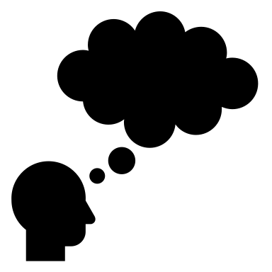


About today’s class
Block 1
Unhealthy diets
Obesity
Malnutrition
Diet & physical health
Diet & mental heath
Causes & correlates of poor dietary intake
Interactive task: What makes a healthy diet?
~10-minute break
Block 2
How can we promote healthy eating behaviour?
Key strategies
Behaviour change models
Common types of intervention
The need for regulatory change
Interactive task: Should we have a sugar tax in the UK?
~5-minute question
& discussion time

Slide 4
Block 1 Unhealthy diets

Slide 5

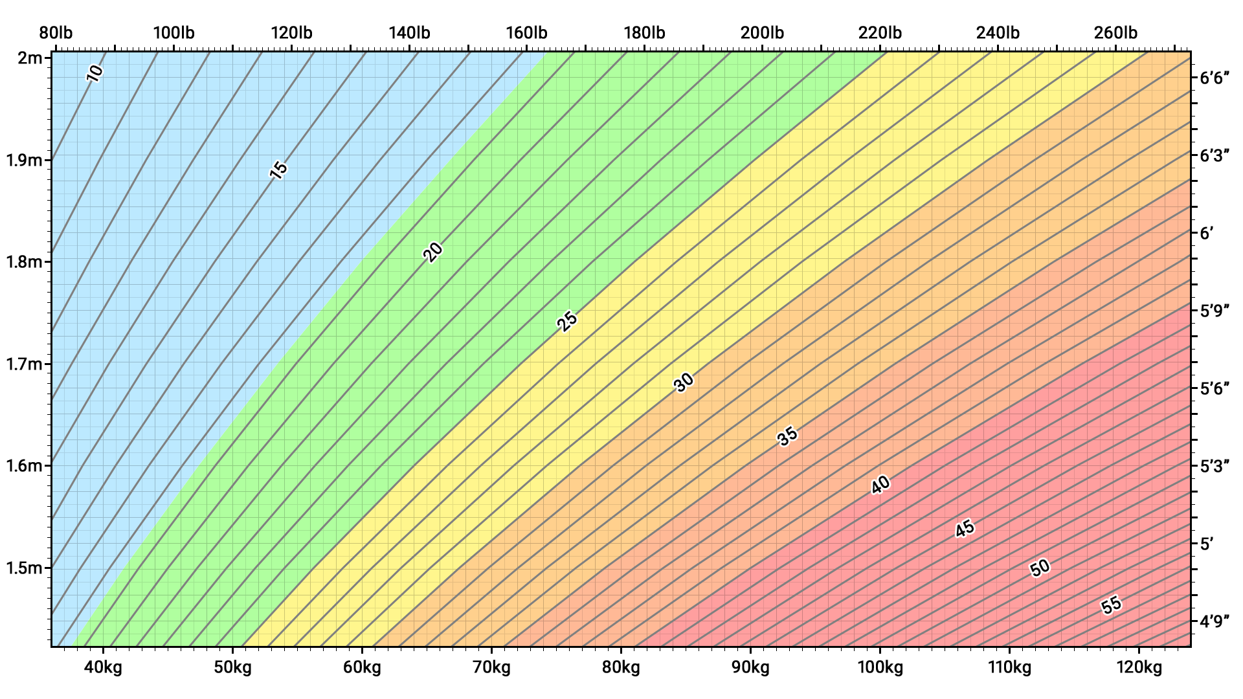
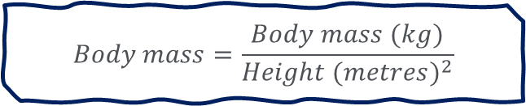
Unhealthy diets
Obesity
Weight categories and obesity are typically defined by Body Mass Index (BMI)
WHO (2022) ranges:
<18.5 = underweight
18.5–24.9 = normal weight (“healthy”)
25–29.9 = overweight
≥30 = obesity
Alternatives:
Visceral fat
Waist-to-hip ratio
$$Body mass=\frac{Body mass (kg)}{{Height (metres)}^{2}}$$
Source: Wiki

Slide 6
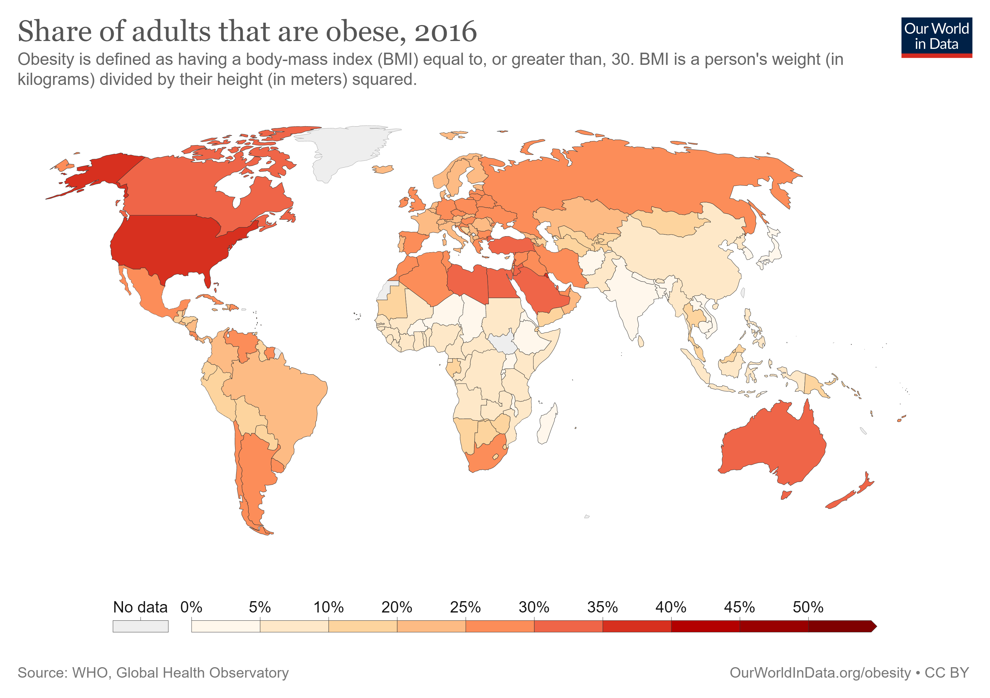
Unhealthy diets
Obesity
WHO (2022):
Worldwide obesity has nearly tripled since 1975.
39% of adults aged 18 years and over were overweight in 2016 (more than 1.9 billion)
13% were obese in 2016 (650 million)
Source: Our world data

Slide 7
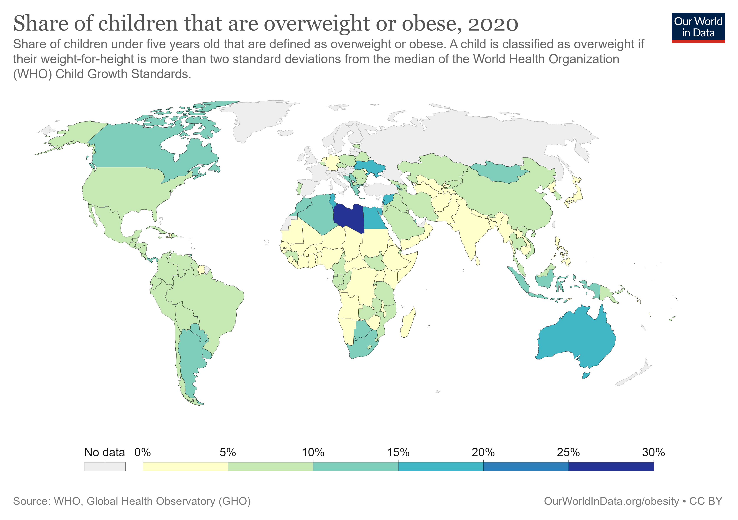
Unhealthy diets
Obesity
WHO (2022) & Abarca-Gómez et al. (2017):
39 million children under the age of 5 were overweight or obese in 2020.
Over 340 million children and adolescents aged 5-19 were overweight or obese in 2016.
Despite this, more children and adolescents are moderately to severely underweight than obese (increasingly concentrated in south Asia and central, east and west Africa; 2017)
Changed now?
Source: Our world data

Slide 8
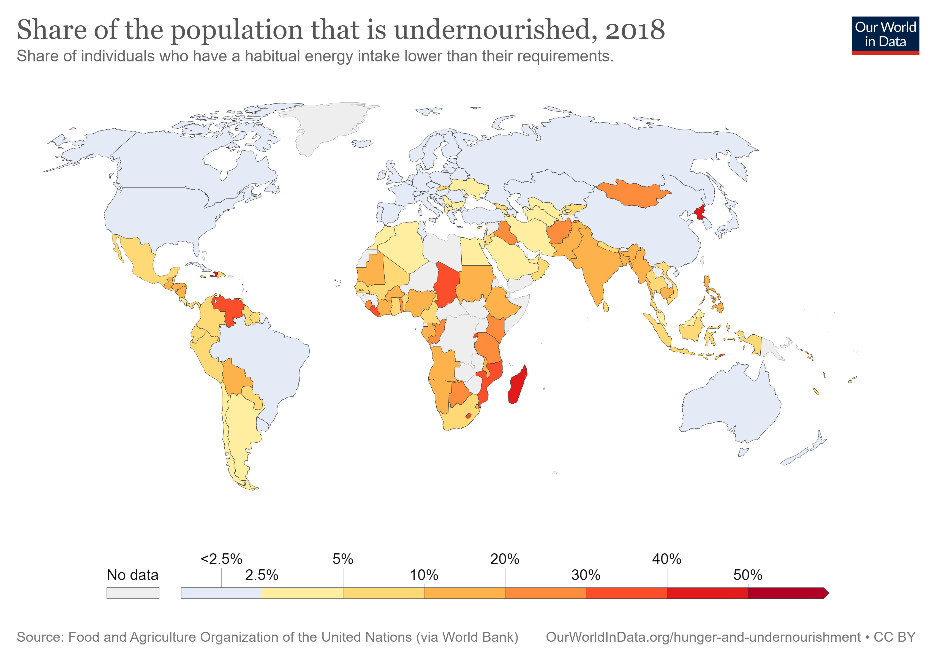
Unhealthy diets
Malnutrition
“lack of proper nutrition, caused by not having enough to eat, not eating enough of the right things, or being unable to use the food that one does eat” (Oxford Dictionary)
“Malnutrition, in all its forms, includes undernutrition (wasting, stunting, underweight), inadequate vitamins or minerals, overweight, obesity, and resulting diet-related noncommunicable diseases” (WHO, 2022).
Source: Our world data

Slide 9
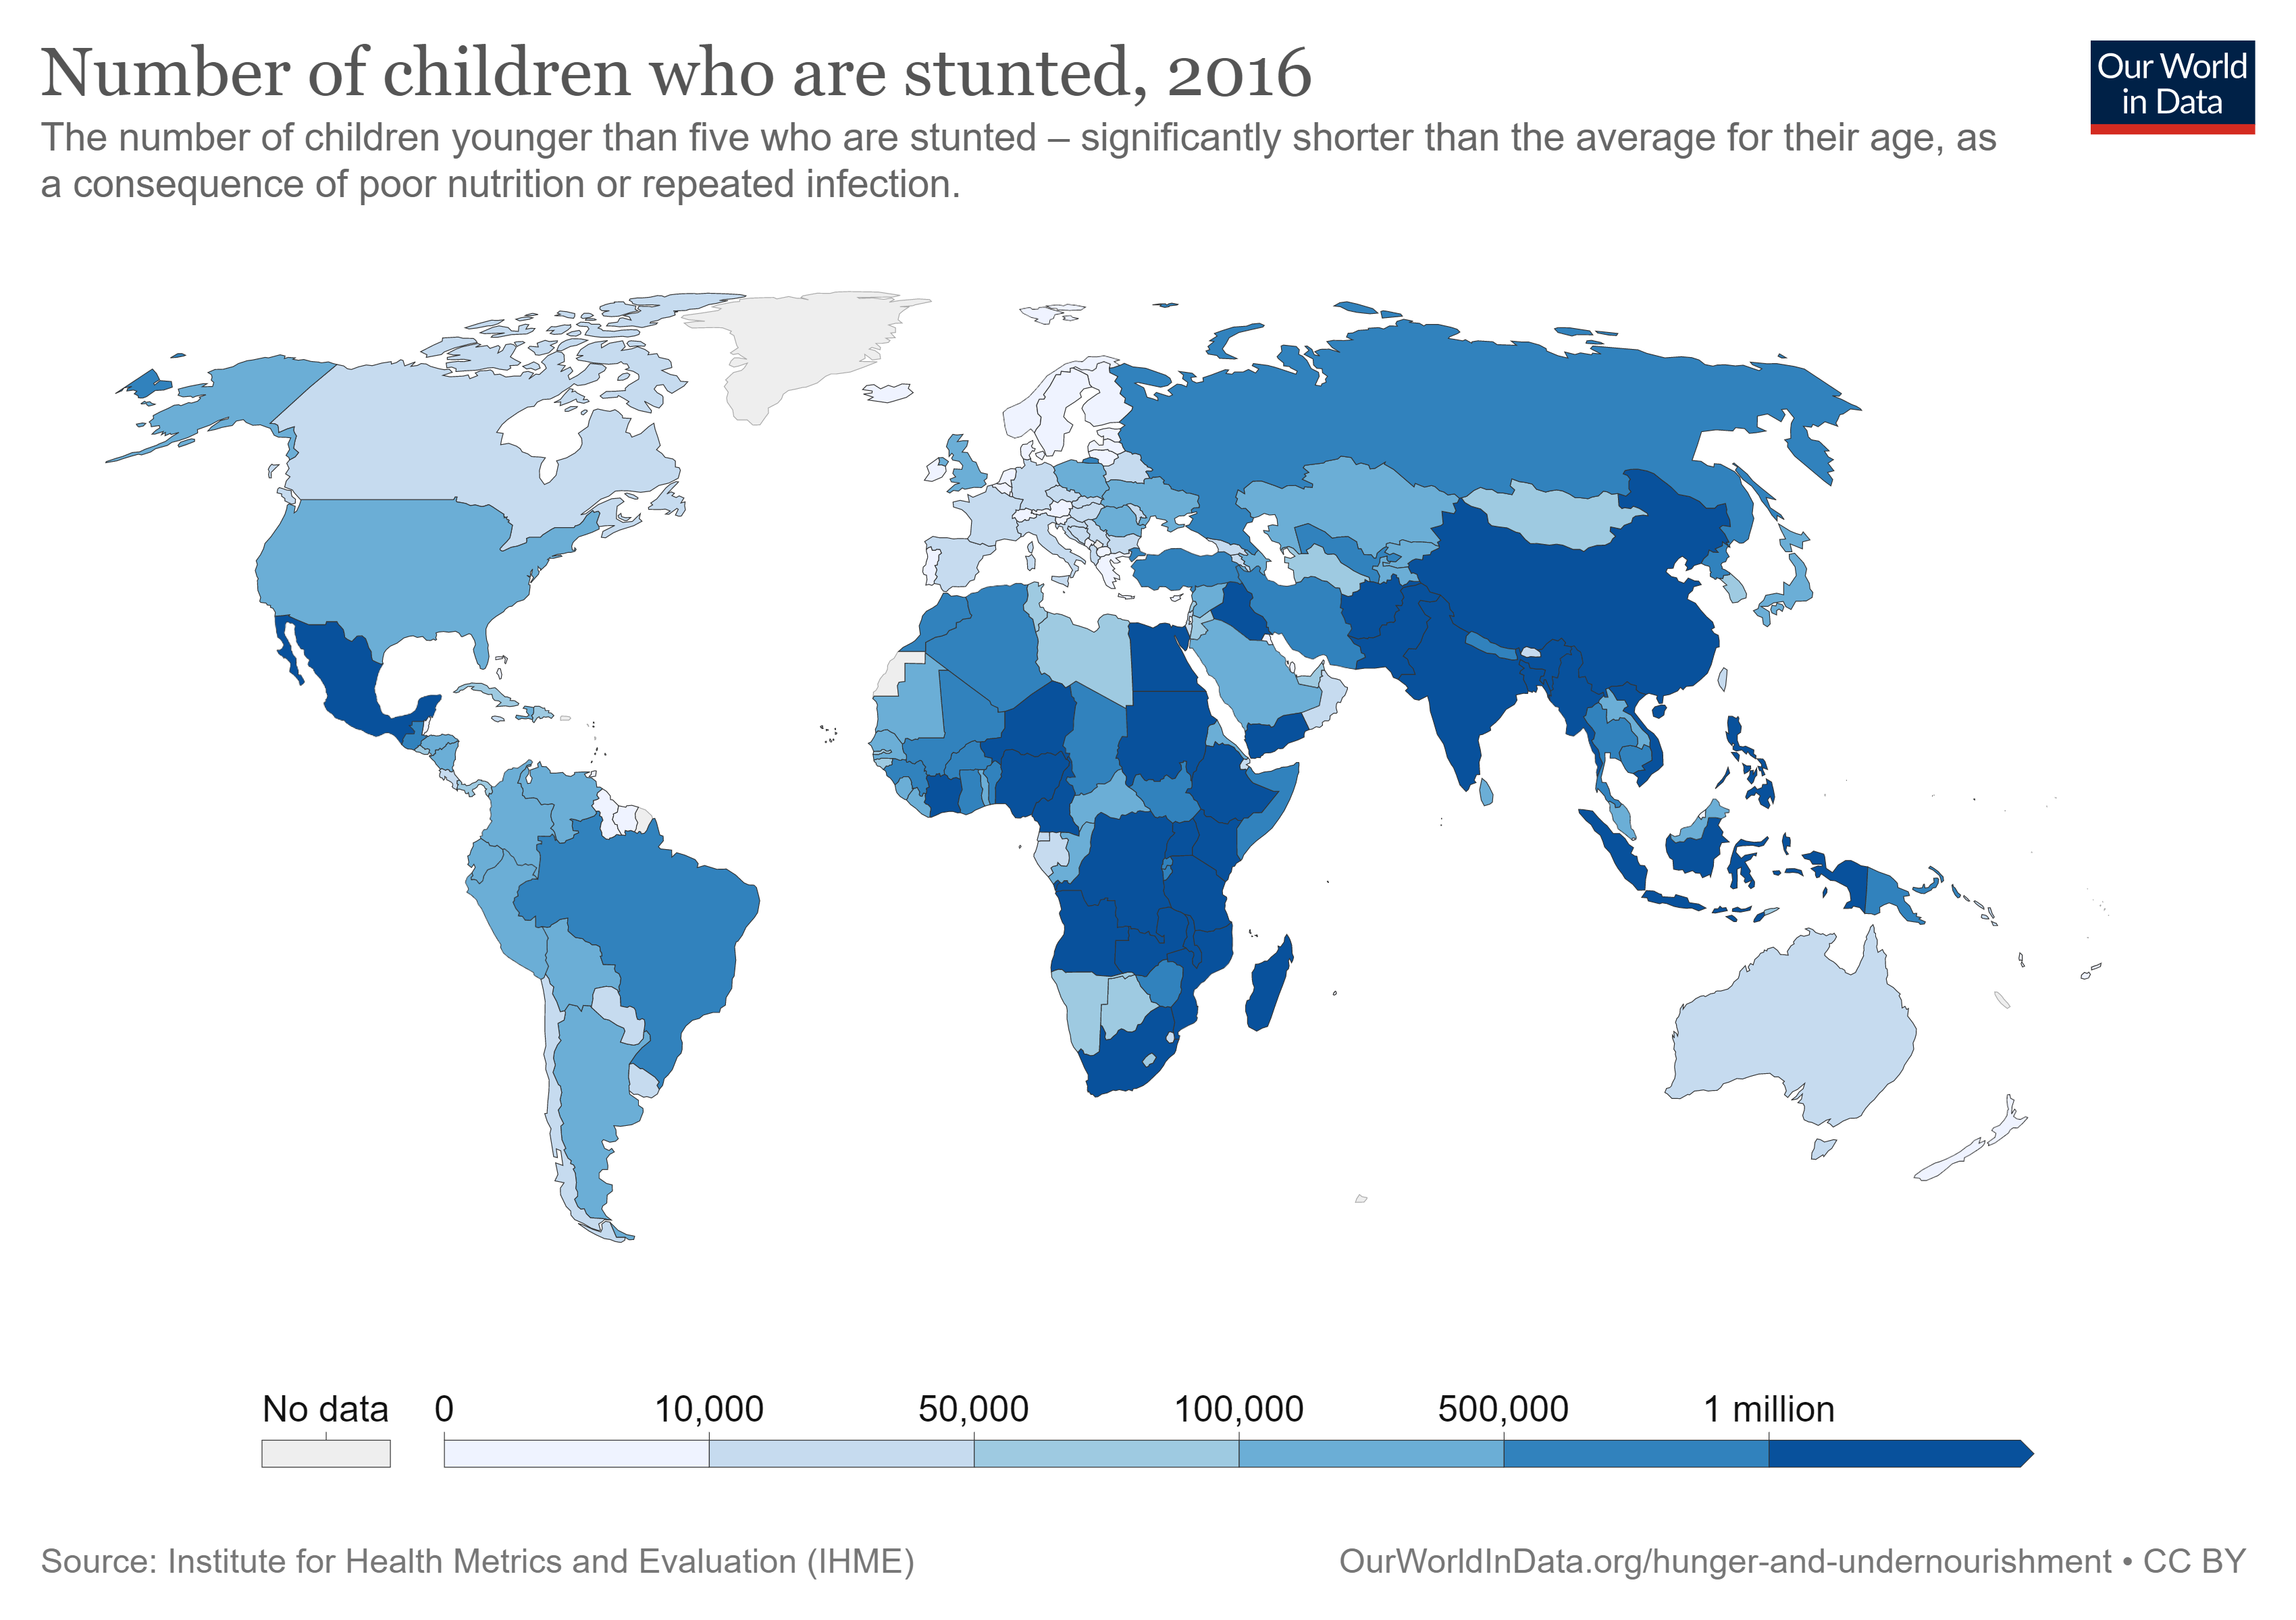
Unhealthy diets
Malnutrition
8.9% of the world are undernourished (663 million people) (Roser & Ritchie, 2019)
22% of children <5 are ‘stunted’ (Roser & Ritchie, 2019)
~42% of children have anemia (Roser & Ritchie (2017)
17.3% of people are deficient in zinc (Wessells & Brown, 2012)
Other common (but decreasing) deficiencies include those of iodine (Biban & Lichiardopol, 2017) and vitamin A (Stevens et al., 2015)
Source: Our world data

Slide 10
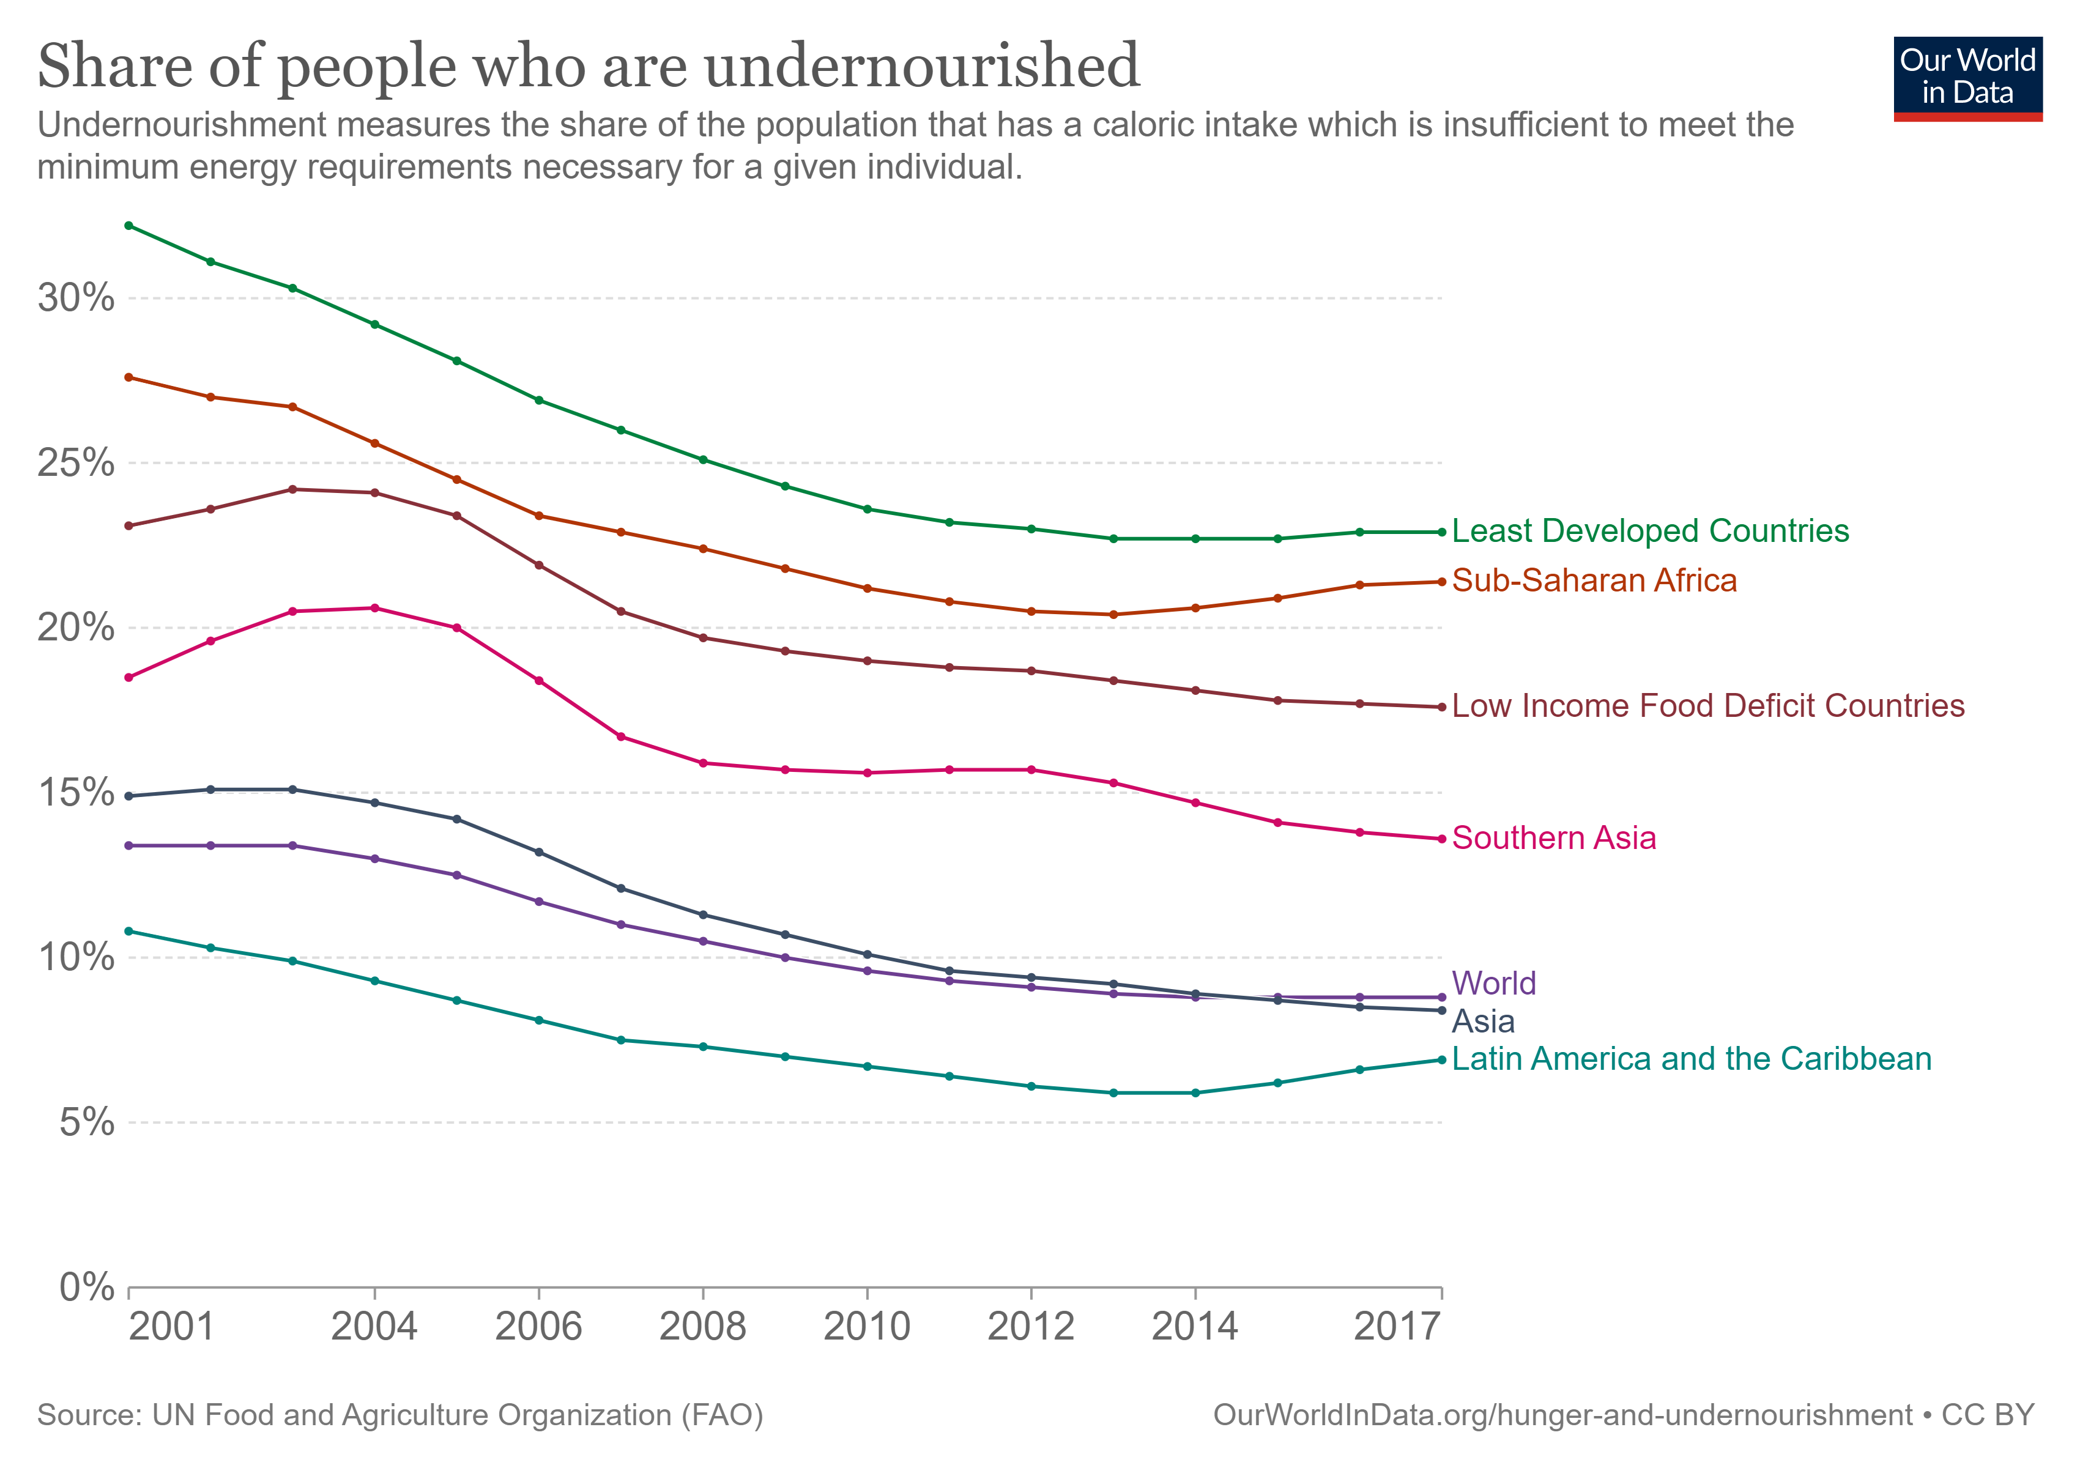
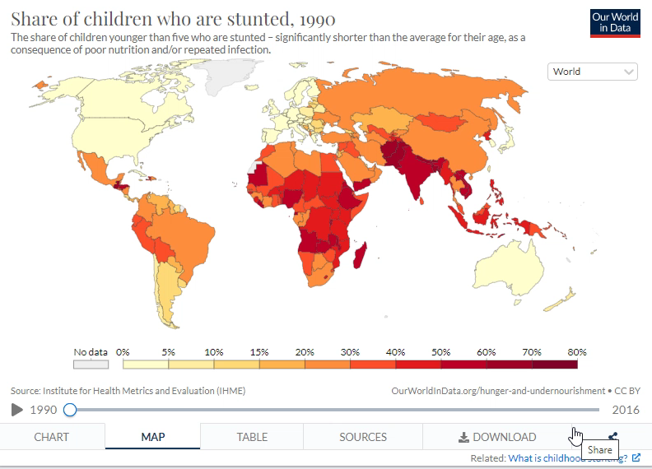
Unhealthy diets
Malnutrition
Source: Our world data
Source: Our world data

Slide 11
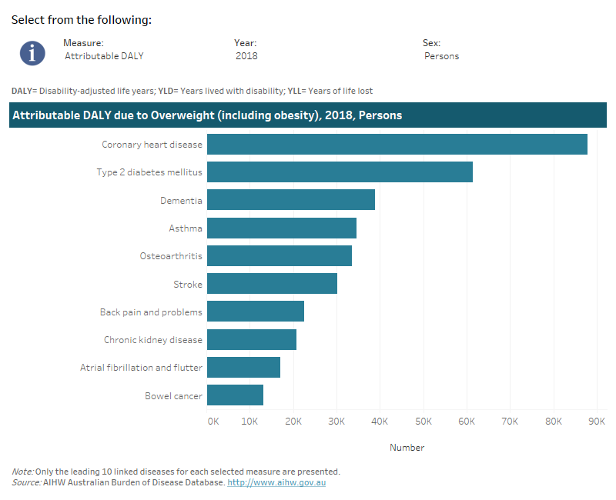
Unhealthy diets
Diet & physical health
Australia in 2018 (Australian Institute of Health and Welfare, 2021):
8.4% of total disease burden in Australia during 2018 attributable to being overweight (2nd only to tobacco use)
Being overweight contributed to 17 types of cancer, for cardiovascular diseases, three musculoskeletal conditions, type II diabetes, dementia, asthma, and kidney disease
Disease burden attributable to being overweight was two times greater in the lower socio-economic group compared to the highest
Source: AIHW

Slide 12
Unhealthy diets
Diet & mental health
Obesity is associated with:
Increased rates of anxiety and depression (Lavallee et al., 2021)
Increased rates of psychosocial problems and suicidal ideation among adolescents (Vuuren et al., 2019)
Depression, conduct disorder, & ADHD among children aged 10-17 (Halfon et al., 2013)
Strongest overall association (among psychiatric disorders) with depression (bi-directional relationship; Rajan & Menon, 2017; Roberts et al., 2003; Scott et al., 2008)
Discussion question
Does obesity cause mental health problems or do mental health problems cause obesity?

Slide 13
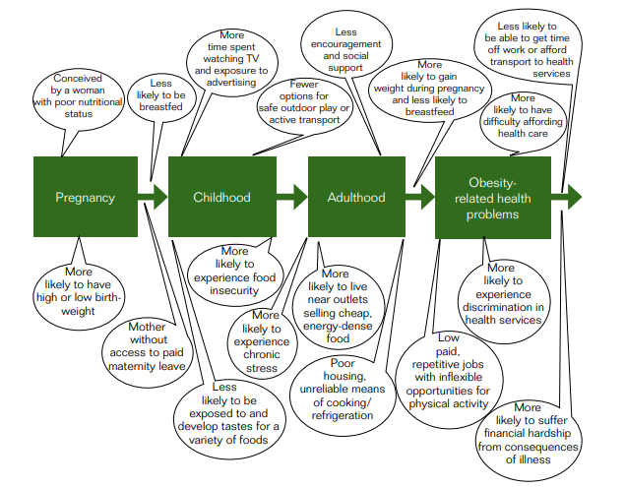
Unhealthy diets
Causes & correlates of poor dietary intake
WHO (2014): How inequalities in obesity compound over the life course
Socio-economic status
Low socio-economic status (higher disadvantage) is consistently associated with higher rates of obesity
The gap between low and high SES appears to be widening (Vincze et al., 2021)
Why?
Increased eating off large plates, eating at night, and uncontrolled eating (Pigeyre et al., 2016)
Higher intake of fat and simple carbohydrates, less fruit, vegetables, and whole wheat bread; reduced exercise facilities; decreased sense of safety (Volaco et al., 2018)
Superficial explanations?

Slide 14
Unhealthy diets
Causes & correlates of poor dietary intake
External eating | Emotional eating | Internal eating | Restraint eating
Eating and catching sight of food or food related cues | Eating when bored, irritated, upset, or stressed | Eating when the body signals hunger | Chronic dieting or intentional restriction of intake to influence body weight but often punctuated with episodes of overeating

Slide 15
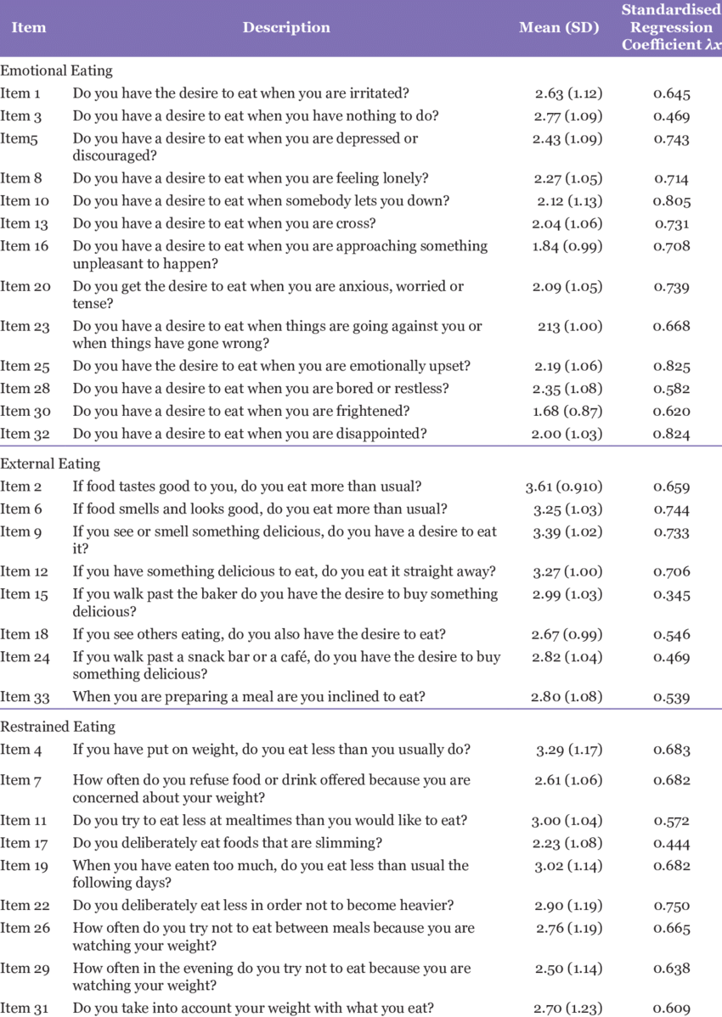
Unhealthy diets
Interactive task: What’s your eating style?
Emotional style & obesity:
Emotional eating frequently associated with increased risk of obesity (Konttinen, 2020)
Emotional eating is associated with more snacking (no external eating association) over a longer period of the day (Magklis, 2019)
Restraint eating may be an even stronger predictor of obesity (Brogan & Hevey, 2013; Adams et al., 2019)
Subramaniam et al.
(2017)

Slide 16
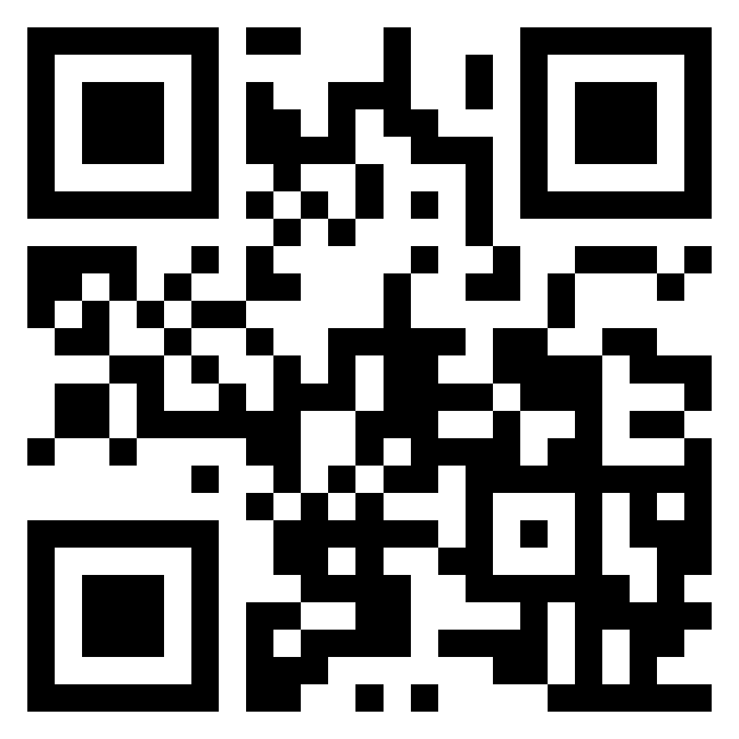
What makes a healthy diet?
Interactive task
Please go to the following site & enter this number:
TBC
What makes a healthy diet?
What do you think?
Login to Menti and add your suggestions
Class discussion
https://www.menti.com/

Slide 17
Block 2 How can we promote healthy eating behaviour?

Slide 18
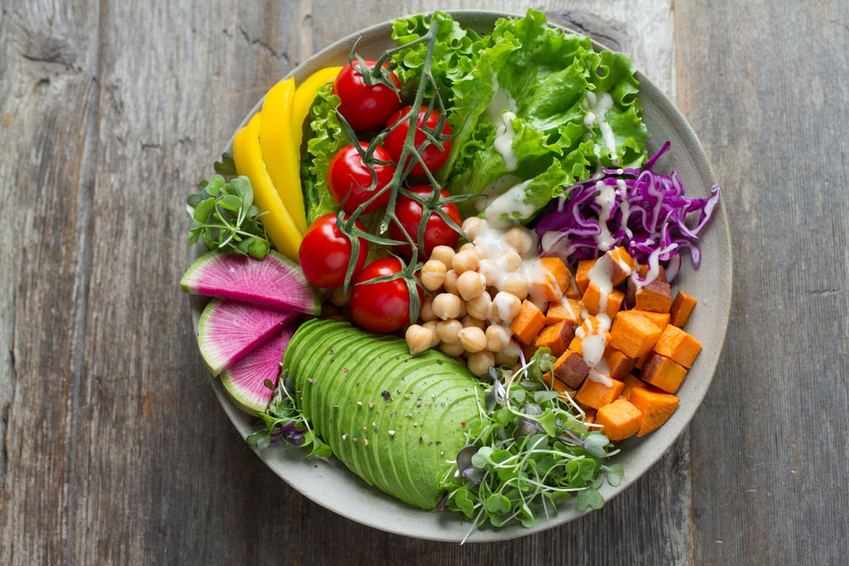
How can we promote healthy eating behaviour?
Key strategies
General requirements of an effective intervention to improve dietary behaviour:
Need to first understand the factors associated with the development of obesity (Morrison et al., 2019)
Act early (Simmonds et al., 2016)
Tailored to the “group” or population targeted
Based on theories/models of health behaviour (Rigby et al., 2020)

Slide 19
How can we promote healthy eating behaviour?
Behaviour change models
Theory of Planned Behaviour (TPB)
Outcome expectancies X outcome value
Attitudes
Demographic variables (e.g., age, sex, race), personality, & past experience
Normative belief X motivation to comply
Subjective norm
Behavioural intention
Behaviour
Perceived internal & external control factors
Perceived behavioural
control
19

Slide 20
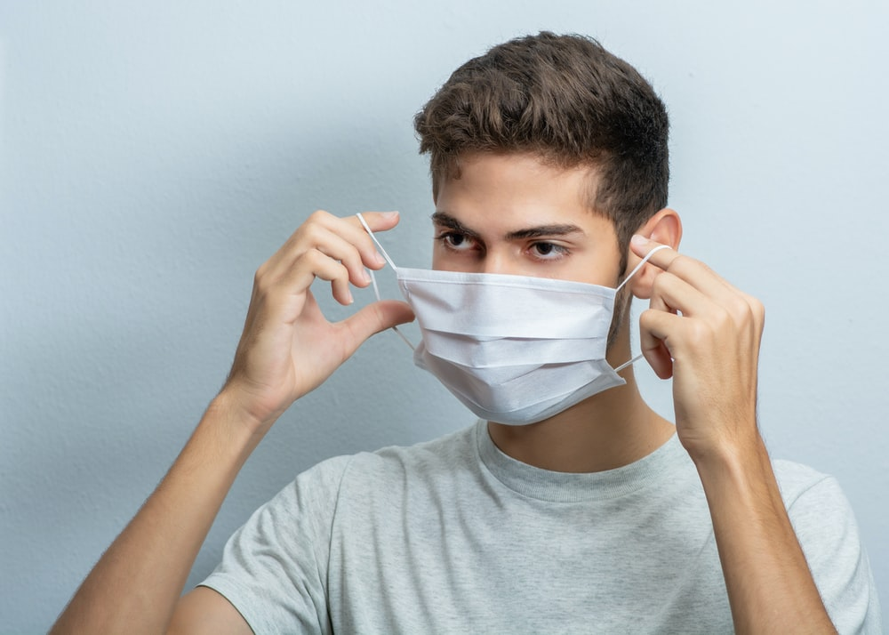
How can we promote healthy eating behaviour?
Behaviour change models
Theory of Planned Behaviour (TPB)
Limitations:
The intention-behaviour gap
Fails to consider many influences on behaviour:
Past experience (Heirene & Gainsbury, 2021)
Habits
Moral norms
Anticipatory regret
Self-identity
Social support
Planning
Benefits & uses:
Generally, a good predictor of engaging with health protective behaviours (Armitage, 2005; Gao et al., 2021; Menozzi et al., 2015; 2017)
Strong predictor of covid-19 protective behaviour Wollast et al., 2021)
Accounts for social influences on behaviour
20

Slide 21

How can we promote healthy eating behaviour?
Behaviour change models
Precontemplation
No intention of changing behaviour
The Transtheoretical Model (TTM)
Relapse
Fall back into earlier behaviour patters
Contemplation
Awareness of problem but not committed to action
Progress through the stages is mediated by decisional balance (e.g., costs versus benefits of the behaviour changes benefits of the behaviour change) and self-efficacy.
Termination
Extended maintenance & total confidence in maintaining behaviour
Maintenance
Behaviour is maintained but vulnerable to relapse
Preparation
Ready to change & setting goals
Action
Overt behaviour change
21

Slide 22
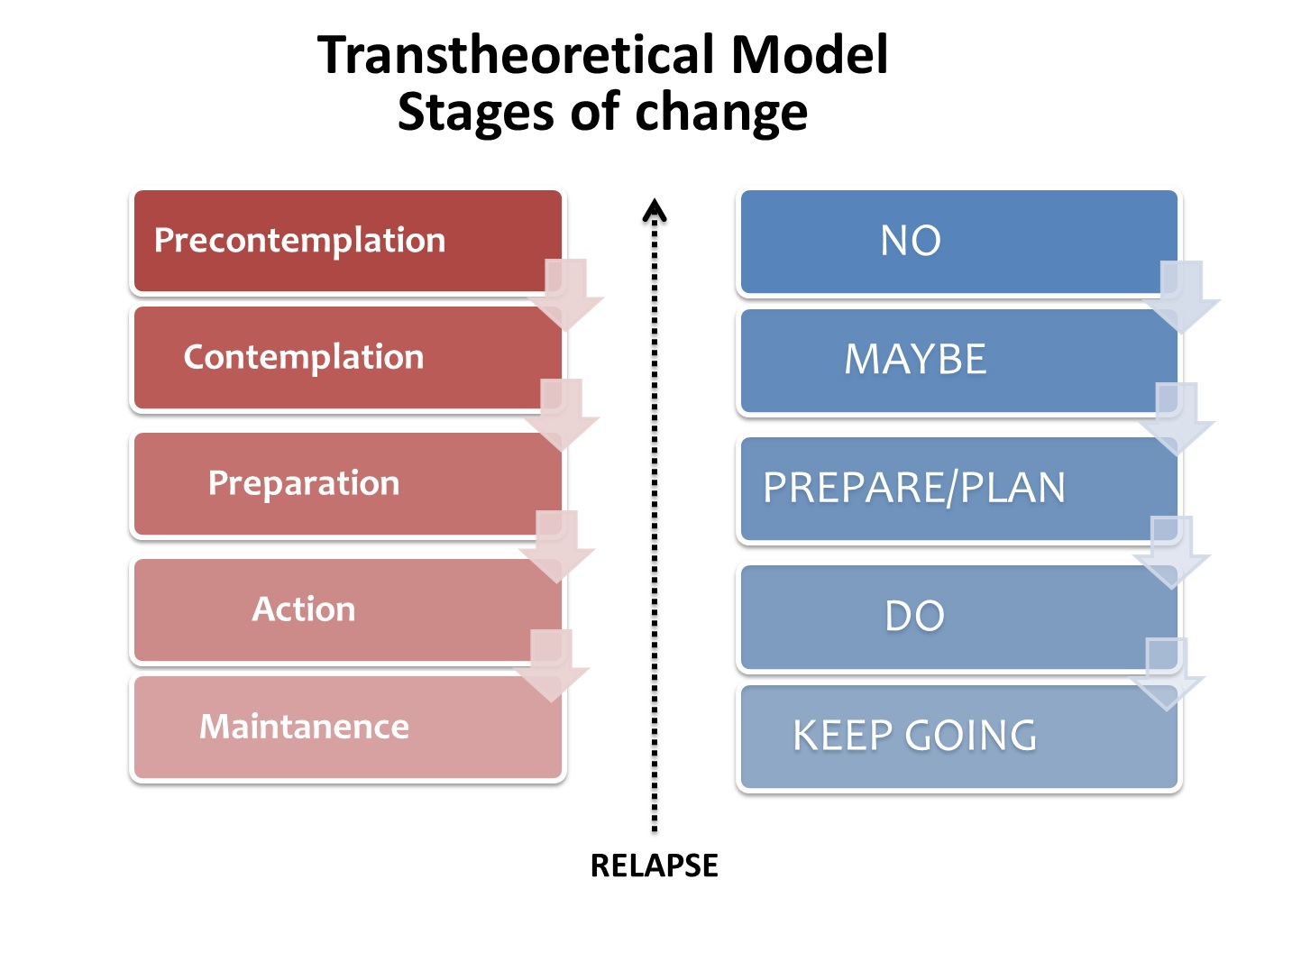
How can we promote healthy eating behaviour?
Behaviour change models
The Transtheoretical Model (TTM)
Limitations:
Doesn’t fully consider:
Past behaviour
Social influences
Value of the five independent stages is questionable
How long does each last?
Assumes (questionable) rational decision making process (i.e., decisional balance)
Benefits & uses:
Provides a framework for considering behaviour change & readiness to change
Recognition that different people are at different stages
Allows clinicians and researchers to make recommendations for people at each stage (Nig et al., 2011)
Stages (in some cases) associated with proposed changes in self-efficacy and perception of benefits and barriers (pros vs. cons; Liu et al., 2018; Wright et al., 2009)
22

Slide 23
How can we promote healthy eating behaviour?
Behaviour change models
Social Cognitive Theory (Bandura, 1986; 2008)
Basing dietary interventions on behaviour change theories (e.g., TPB, TTM/SoC)
Randomised controlled trials of dietary behaviour change using behaviour change models are more effective (Michie et al., 2009; Rigby et al., 2020)
Most behaviour change interventions appear to use Social Cognitive Theory (Matenga-Ikihele et al., 2021; Rigby et al., 2020)
Personal factors
The behaviour
Environmental factors
Discussion question
Why might using behavioural change models improved intervention effectiveness?

Slide 24
How can we promote healthy eating behaviour?
Common types of intervention
Common interventions used to tackle poor diets & obesity (Walls et al., 2011)
Community-based interventions
Building sport, exercise, and play facilities; hiring sports instructors; adapting environment to encourage exercise behaviours (e.g., cycle paths); offering cooking classes changing school menus; encouraging active play among children
(See also Haby et al., 2012)
Social marketing campaigns
Media campaigns that emphasise the importance of healthy eating and physical activity; media campaigns that emphasise the desirability of achieving a healthy body weight; social modelling as a behaviour change strategy
(See also Evans et al., 2012)
Drug therapies
There are a small number approved anti-obesity drugs available.
Most have shown limited efficacy and considerable adverse effects (many have been withdrawn from prescription /sale)
(See also Cheung et al., 2013)
Surgery
Bariatric surgeries include gastric bypasses and sleeve gastrectomy
Typically only used in cases where: BMI > 40, diet and exercise have failed, obesity–related comorbidities are present (diabetes, sleep apnoea)
(See also Glandt & Raz, 2011)

Slide 25
How can we promote healthy eating behaviour?
The need for regulatory change
Ways forward (Walls et al., 2011) with obesity campaigns:
Strategies reliant on individual behaviour change are unlikely to be effective
The “individual choice” approach is insufficient
Society-wide changes that facilitate dietary behaviour change are needed
Regulation in other areas of public health has proved extremely effective (e.g., seat belts, smoking, vaccinations)
Regulatory approaches reduce inequalities in obesity
Frieden et al.’s (2017) three-pronged strategy
Food pricing adjustments (subsidies on fruits and vegetables and taxation is applied to energy-dense and nutrient-poor foods)
Increasing exposure to healthy food and decreasing exposure to unhealthy food display and location restrictions)
Improving the image of healthy food and making unhealthy food less attractive ( restrictions on advertising and presentation of foods)

Slide 26
How can we promote healthy eating behaviour? Interactive task
Please go to the following site & enter this number:
TBC
Should we have a sugar tax in the UK?
Why or why not?
What do you think?
Do some research: What does the evidence say?
Login to Menti and add your findings and suggestions
Class discussion
https://www.menti.com/

Slide 27
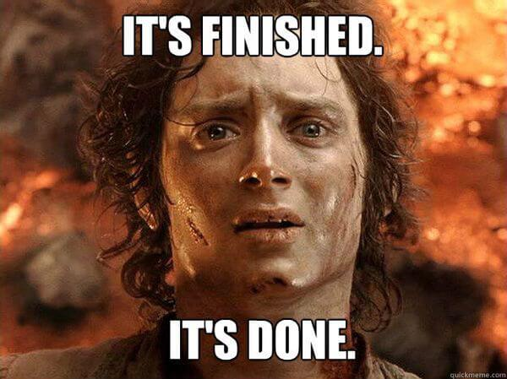
Next week: Easter break

Slide 28
Credits & Sources
If an image in this slideshow does not have a link to the source posted below it, then I have either taken the picture myself or taken it from the site www.unsplash.com and clicking the image will take you to the original source on unsplash.

Slide 29
References
Abarca-Gómez, L., Abdeen, Z. A., Hamid, Z. A., Abu-Rmeileh, N. M., Acosta-Cazares, B., Acuin, C., Adams, R. J., Aekplakorn, W., Afsana, K., Aguilar-Salinas, C. A., Agyemang, C., Ahmadvand, A., Ahrens, W., Ajlouni, K., Akhtaeva, N., Al-Hazzaa, H. M., Al-Othman, A. R., Al-Raddadi, R., Buhairan, F. A., … Ezzati, M. (2017). Worldwide trends in body-mass index, underweight, overweight, and obesity from 1975 to 2016: a pooled analysis of 2416 population-based measurement sBIBAN, B. & LICHIARDOPOL, C. (2017). Iodine Deficiency, Still a Global Problem? Current Health Sciences Journal, 43(2), 103–111. https://doi.org/10.12865/chsj.43.02.01tudies in 128·9 million children, adolescents, and adults. The Lancet, 390(10113), 2627–2642. https://doi.org/10.1016/s0140-6736(17)32129-3
Adams, R. C., Chambers, C. D. & Lawrence, N. S. (2019). Do restrained eaters show increased BMI, food craving and disinhibited eating? A comparison of the Restraint Scale and the Restrained Eating scale of the Dutch Eating Behaviour Questionnaire. Royal Society Open Science, 6(6), 190174. https://doi.org/10.1098/rsos.190174
Australian Institute of Health and Welfare (2021) Australian Burden of Disease Study 2018: Interactive data on risk factor burden, AIHW, Australian Government. https://www.aihw.gov.au/reports/burden-of-disease/abds-2018-interactive-data-risk-factors/contents/about
Bandura, A. (1986). Social foundations of thought and action: A social cognitive theory. Englewood Cliffs, NJ: Prentice Hall.
Bandura, A. (2008). Social Cognitive Theory. The International Encyclopedia of Communication. https://doi.org/10.1002/9781405186407.wbiecs053

Slide 30
References
Cheung, B. M. Y., Cheung, T. T. & Samaranayake, N. R. (2013). Safety of antiobesity drugs. Therapeutic Advances in Drug Safety, 4(4), 171–181. https://doi.org/10.1177/2042098613489721
Brogan, A. & Hevey, D. (2013). Eating styles in the morbidly obese: Restraint eating, but not emotional and external eating, predicts dietary behaviour. Psychology & Health, 28(6), 714–725. https://doi.org/10.1080/08870446.2012.760033
Evans, W. D., Christoffel, K. K., Necheles, J. W. & Becker, A. B. (2010). Social Marketing as a Childhood Obesity Prevention Strategy. Obesity, 18(S1), S23–S26. https://doi.org/10.1038/oby.2009.428
Frieden, T. R., Dietz, W. & Collins, J. (2017). Reducing Childhood Obesity Through Policy Change: Acting Now To Prevent Obesity. Health Affairs, 29(3), 357–363. https://doi.org/10.1377/hlthaff.2010.0039
Glandt, M. & Raz, I. (2011). Present and Future: Pharmacologic Treatment of Obesity. Journal of Obesity, 2011, 636181. https://doi.org/10.1155/2011/636181
Haby, M. M., Doherty, R., Welch, N. & Mason, V. (2012). Community-based interventions for obesity prevention: lessons learned by Australian policy-makers. BMC Research Notes, 5(1), 20–20. https://doi.org/10.1186/1756-0500-5-20
Hudson S. Healthy stores, healthy communities: the impact of outback stores on remote indigenous Australians. St Leonards: Centre for Independent Studies; 2010
Konttinen, H. (2020). Emotional eating and obesity in adults: the role of depression, sleep and genes. Proceedings of the Nutrition Society, 79(3), 283–289. https://doi.org/10.1017/s0029665120000166

Slide 31
References
Kreuter, M. W., Lukwago, S. N., Bucholtz, D. C., Clark, E. M. & Sanders-Thompson, V. (2003). Achieving Cultural Appropriateness in Health Promotion Programs: Targeted and Tailored Approaches. Health Education & Behavior, 30(2), 133–146. https://doi.org/10.1177/1090198102251021
Lavallee, K. L., Zhang, X. C., Schneider, S. & Margraf, J. (2021). Obesity and Mental Health: A Longitudinal, Cross-Cultural Examination in Germany and China. Frontiers in Psychology, 12, 712567. https://doi.org/10.3389/fpsyg.2021.712567
Magklis, E., Howe, L. D. & Johnson, L. (2019). Eating Style and the Frequency, Size and Timing of Eating Occasions: A cross-sectional analysis using 7-day weighed dietary records. Scientific Reports, 9(1), 15133. https://doi.org/10.1038/s41598-019-51534-w
Matenga-Ikihele, A., McCool, J., Dobson, R., Fa’alau, F. & Whittaker, R. (2021). The characteristics of behaviour change interventions used among Pacific people: a systematic search and narrative synthesis. BMC Public Health, 21(1), 435. https://doi.org/10.1186/s12889-021-10420-9
Michie, S., Abraham, C., Whittington, C., McAteer, J. & Gupta, S. (2009). Effective Techniques in Healthy Eating and Physical Activity Interventions: A Meta-Regression. Health Psychology, 28(6), 690–701. https://doi.org/10.1037/a0016136

Slide 32
References
Pigeyre, M., Rousseaux, J., Trouiller, P., Dumont, J., Goumidi, L., Bonte, D., Dumont, M.-P., Chmielewski, A., Duhamel, A., Amouyel, P., Dallongeville, J., Romon, M. & Meirhaeghe, A. (2016). How obesity relates to socio-economic status: identification of eating behavior mediators. International Journal of Obesity, 40(11), 1794–1801. https://doi.org/10.1038/ijo.2016.109
Rajan, T. & Menon, V. (2017). Psychiatric disorders and obesity: A review of association studies. Journal of Postgraduate Medicine, 63(3), 182–190. https://doi.org/10.4103/jpgm.jpgm_712_16
Resnicow, K., Baranowski, T., Ahluwalia, J. S. & Braithwaite, R. L. (1999). Cultural sensitivity in public health: defined and demystified. Ethnicity & Disease, 9(1), 10–21.
Rigby, R. R., Mitchell, L. J., Hamilton, K. & Williams, L. T. (2020). The Use of Behavior Change Theories in Dietetics Practice in Primary Health Care: A Systematic Review of Randomized Controlled Trials. Journal of the Academy of Nutrition and Dietetics, 120(7), 1172–1197. https://doi.org/10.1016/j.jand.2020.03.019
Roberts, R. E., Deleger, S., Strawbridge, W. J. & Kaplan, G. A. (2003). Prospective association between obesity and depression: evidence from the Alameda County Study. International Journal of Obesity, 27(4), 514–521. https://doi.org/10.1038/sj.ijo.0802204
Roser, M., & Ritchie, H. (2017) - "Micronutrient Deficiency". Published online at OurWorldInData.org. Retrieved from: 'https://ourworldindata.org/micronutrient-deficiency' [Online Resource]
Roser, M., & Ritchie, H. (2019). "Hunger and Undernourishment". Published online at OurWorldInData.org. Retrieved from: 'https://ourworldindata.org/hunger-and-undernourishment' [Online Resource]

Slide 33
References
Scott, K. M., Bruffaerts, R., Simon, G. E., Alonso, J., Angermeyer, M., Girolamo, G. de, Demyttenaere, K., Gasquet, I., Haro, J. M., Karam, E., Kessler, R. C., Levinson, D., Mora, M. E. M., Browne, M. A. O., Ormel, J., Villa, J. P., Uda, H. & Korff, M. V. (2008). Obesity and mental disorders in the general population: results from the world mental health surveys. International Journal of Obesity, 32(1), 192–200. https://doi.org/10.1038/sj.ijo.0803701
Simmonds, M., Llewellyn, A., Owen, C. G. & Woolacott, N. (2016). Predicting adult obesity from childhood obesity: a systematic review and meta-analysis. Obesity Reviews, 17(2), 95–107. https://doi.org/10.1111/obr.12334
Stevens, G. A., Bennett, J. E., Hennocq, Q., Lu, Y., De-Regil, L. M., Rogers, L., Danaei, G., Li, G., White, R. A., Flaxman, S. R., Oehrle, S.-P., Finucane, M. M., Guerrero, R., Bhutta, Z. A., Then-Paulino, A., Fawzi, W., Black, R. E. & Ezzati, M. (2015). Trends and mortality effects of vitamin A deficiency in children in 138 low-income and middle-income countries between 1991 and 2013: a pooled analysis of population-based surveys. The Lancet Global Health, 3(9), e528–e536. https://doi.org/10.1016/s2214-109x(15)00039-x
Subramaniam, K., Low, W. Y., Chinna, K., Chin, K. F. & Krishnaswamy, S. (2017). Psychometric Properties of the Malay Version of the Dutch Eating Behaviour Questionnaire (DEBQ) in a Sample of Malaysian Adults Attending a Health Care Facility. Malaysian Journal of Medical Sciences, 24(4), 64–73. https://doi.org/10.21315/mjms2017.24.4.8
Vincze, L., Barnes, K., Somerville, M., Littlewood, R., Atkins, H., Rogany, A. & Williams, L. T. (2021). Cultural adaptation of health interventions including a nutrition component in Indigenous peoples: a systematic scoping review. International Journal for Equity in Health, 20(1), 125. https://doi.org/10.1186/s12939-021-01462-x

Slide 34
References
Volaco, A., Cavalcanti, A. M., Filho, R. P. & Precoma, D. B. (2018). Socioeconomic Status: The Missing Link Between Obesity and Diabetes Mellitus? Current Diabetes Reviews, 14(4), 321–326. https://doi.org/10.2174/1573399813666170621123227
Vuuren, C. L. van, Wachter, G. G., Veenstra, R., Rijnhart, J. J. M., Wal, M. F. van der, Chinapaw, M. J. M. & Busch, V. (2019). Associations between overweight and mental health problems among adolescents, and the mediating role of victimization. BMC Public Health, 19(1), 612. https://doi.org/10.1186/s12889-019-6832-z
Walls, H. L., Peeters, A., Proietto, J. & McNeil, J. J. (2011). Public health campaigns and obesity - a critique. BMC Public Health, 11(1), 136. https://doi.org/10.1186/1471-2458-11-136
Wessells, K. R. & Brown, K. H. (2012). Estimating the Global Prevalence of Zinc Deficiency: Results Based on Zinc Availability in National Food Supplies and the Prevalence of Stunting. PLoS ONE, 7(11), e50568. https://doi.org/10.1371/journal.pone.0050568
World Health Organisation (WHO). ( 2014). Obesity and in equities. Guidance for addressing inequities in overweight and obesity. https://www.euro.who.int/__data/assets/pdf_file/0003/247638/obesity-090514.pdf

